Slide 1
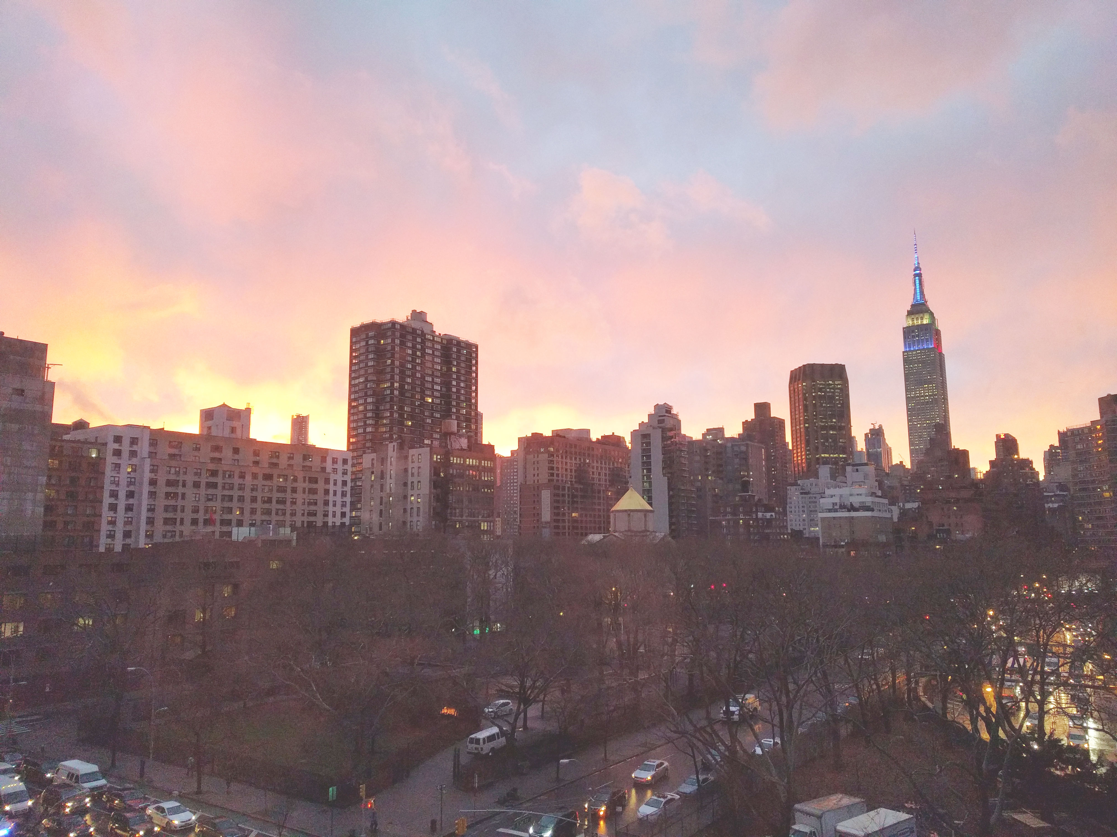

Slide 2
Introductions
Co-Organizers
Brian Jablonsky
Erik Noren

Slide 3
News
Follow us on Twitter: @NYCDotNetDevs
.NET May 2021 Updates - https://bit.ly/3bHiBg4
.NET Framework 4.5/4.6/4.6.1 End of Support - https://bit.ly/3fsXgbe
Visual Studio 2022 - https://bit.ly/2SXPChk
Azure Static Web Apps GA - https://bit.ly/3bGRt0F

Slide 4
Other NYC Meetings
TBA – NYC Mobile .NET “TBD” (https://www.meetup.com/nycmobiledev/)
Thursday, June 10th – NYC PowerShell Meetup “Toast Notifications with PowerShell: From Noob to Master Baker” (https://www.meetup.com/NycPowershellMeetup/)

Slide 5
.NET Virtual User Group
https://dotnetfoundation.org/community/virtual-user-group
Attend another .NET User Group virtually!
Constantly adding new user group meetings
Replay some of the meetings you might have missed

Slide 6
Upcoming Meetings
Thursday, June 10th – “Building Event-driven Microservices with the Azure Cosmos DB Change Feed”
Thursday, July 8th – TBA
Thursday, August 12th – TBA
Thursday, September 9th – “Blockchain and Smart Contracts using C#”
TBD, October – Hacktoberfest
Thursday, November 11th – TBA
Thursday, December 9th – TBA

Slide 7
Microsoft Build 2021
Free
Online
May 25th – 27th, 2021
https://register.build.microsoft.com/

Slide 8
Announcements
Call for presentations!
Have an idea/topic for a presentation?
Want to give a presentation?
Contact Erik (erik@nycdotnetdevs.com) or Brian (brian@nycdotnetdevs.com), or tweet @NYCDotNetDevs

Slide 9
Announcements
State of User Group Survey
We’ll be sending out a survey via Meetup to gauge your interest in what you want to see from the user group
Submit your survey anonymously, or add an email address and be entered to win some prizes ($25 Amazon gift cards, .NET merch, JetBrains licenses, etc)

Slide 10

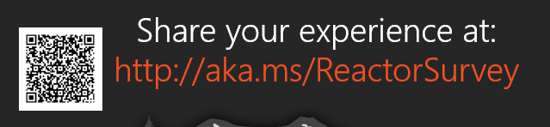
Sponsors
Microsoft Reactor http://microsoftreactor.com
Microsoft Reactors are developer community hubs providing technical events, community networking, and collaboration. They are graciously sponsoring our group in 2019 by providing our meeting space and food! Please fill out the survey at the end of the meeting!

Slide 11

Sponsors
PostSharp http://www.postsharp.net/
PostSharp is a compiler extension that adds support for patterns to C# and VB. If you’re tired of writing repetitive code, you may want to check it out. It can help you add logging, caching or INotifyPropertyChanged to your codebase without boilerplate, or solve multithreading issues.

Slide 12

Sponsors
RevDeBug https://revdebug.com
RevDeBug allows you to inspect past application state and performance profile, even directly from production environments. Trace the root cause of bugs in a matter of seconds, saving your developers' time and sanity.

Slide 13

Sponsors
JetBrains https://jetbrains.com
For over 15 years, JetBrains has strived to make the strongest, most effective developer tools on earth. By automating routine checks and corrections, JetBrains tools speed up production, freeing developers to grow, discover and create.

Slide 14
After Meeting Raffle
We have a 2 JetBrains licenses to be given away at the end of the meeting so stick around!

Slide 15

Sean Whitesell
https://twitter.com/codewithseanw
Microsoft MVP
President of Tulsa .NET User Group

Slide 16

Reactor NYC
@MSFTReactor
#ReactorNYC
How was your Meeting?

Slide 17

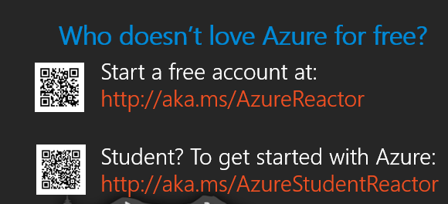

Reactor NYC
@MSFTReactor
#ReactorNYC

